Slide 1

Software Development & Best Practices
Lecture 5 – OWASP & Injection Attacks

Slide 2
What is OWASP?
Open Web Application Security Project was announced September 24th 2001
To provide transparent access to advice on secure coding and threats to web applications.
Provides many publications to help developers write secure code:
OWASP Top 10
OWASP Software Assurance Maturity Model
OWASP Development Guide
OWASP Testing Guide
OWASP Code Review Guide
All open source

Slide 3
OWASP - Top 10
First published in 2003
Purpose: To highlight the most critical risks to web applications
Classes of attack, not specific bugs!
Used by PCI-DSS standard, FTC, and other organizations
Working with the 2017 edition (2021 edition is out!)
In this course we will cover these ten issues of web application security, how to test for them and how to recognize code containing them.

Slide 4

A1:2017-Injection
Theory

Slide 5
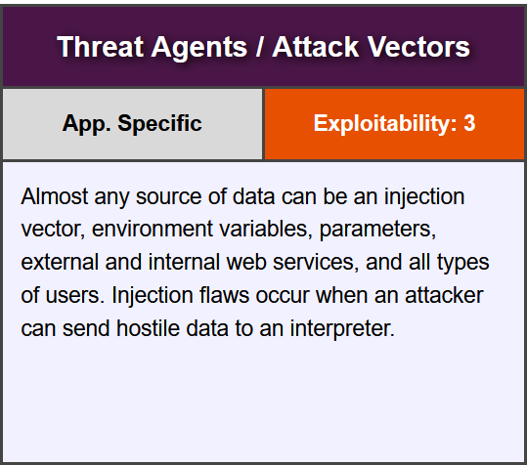
A1:2017-Injection

Slide 6
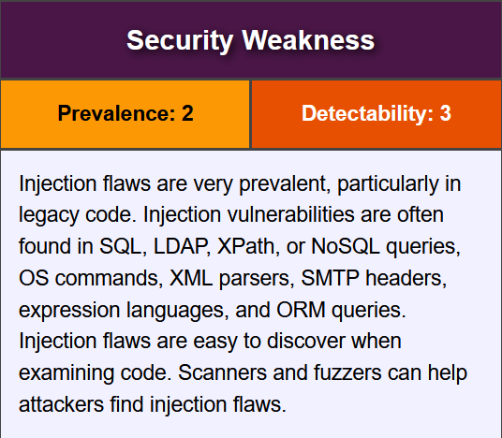
A1:2017-Injection

Slide 7
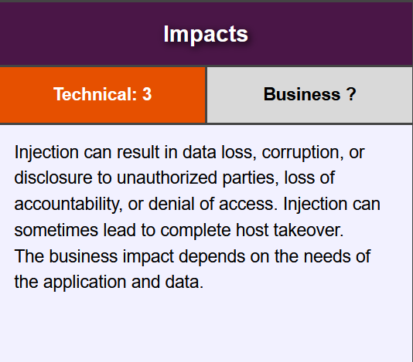
A1:2017-Injection

Slide 8
A1:2017-Injection
Examples

Slide 9
Code & Command injection
Command Injection is the name we give to an attack where a web application which normally executes an operating system command (like “dir,” or “ls”) and forces it to execute a different operating system command or makes the command operate in a way that wasn’t intended by the developer.
When an attacker takes a web application and forces it to execute malicious code we refer to this as code injection.

Slide 10
command Injection - example
Here we have a simple application which uses the Linux command “ls” to display the contents of the current directory!
The app is executed by going to the following URL on the machine that is hosting the application:
http://<<server IP>>/showdir.php
The “exec” function in this PHP file. Causes the server to execute the Linux command: ls
<?php printf ("Contents of the ./test directory<br><br>"); $input = $_GET["filter"]; exec("ls ".$input,$output); foreach ($output as $line) { printf("%s<br>",$line); } ?>

Slide 11
command Injection - example
The developer of this application has provided a handy method to filter the results by providing a parameter called “filter” when can be passed to the script on the URL line.
If, for example we wanted to see only the files that ended with “php” we could go to the URL
http://<<server IP>>/showdir.php&filter=*.php
To the server that would cause it to execute the command:
ls *.php
<?php printf ("Contents of the ./test directory<br><br>"); $input = $_GET["filter"]; exec("ls ".$input,$output); foreach ($output as $line) { printf("%s<br>",$line); } ?>

Slide 12
command Injection - example
So, what’s the problem?
There are no restrictions on…
The size or kind of data we can provide to $_GET
The data we can pass to exec
The output that can be passed back to the user.
<?php printf ("Contents of the ./test directory<br><br>"); $input = $_GET["filter"]; exec("ls ".$input,$output); foreach ($output as $line) { printf("%s<br>",$line); } ?>

Slide 13
command Injection - example
So, lets do a little reconnaissance.
First, lets’ see if we can access any other directories!
We can do this by passing the characters “..” as the “filter” parameter.
In Linux “..” tells the “ls” command to show us the contents of the directory above the one we are currently in.
Changing the filter in this way lets us start moving around the computer’s directory structure!
<?php printf ("Contents of the ./test directory<br><br>"); $input = $_GET["filter"]; exec("ls ".$input,$output); foreach ($output as $line) { printf("%s<br>",$line); } ?>

Slide 14
command Injection - example
Another trick is to use the “;” character. In Linux this allows us to put multiple commands on the same line. If we pass this to “filter” we can ask this app to perform any command, we want!
Two Linux commands which can be useful when investigating a system are:
stat – Linux command which tells us the permissions on a specific file.
whoami – Linux command that tells us the username of the current account.
Try these commands on your TurnKey System and see what you can find out!
<?php printf ("Contents of the ./test directory<br><br>"); $input = $_GET["filter"]; exec("ls ".$input,$output); foreach ($output as $line) { printf("%s<br>",$line); } ?>

Slide 15
Code Injection - example
By using stat on this machine for example. We might be able to find a directory that has Read, Write and Execute permissions!
PHP code usually requires these permissions to be able to run. Finding a directory that has these allows us to upload our own PHP script and then run it.
Your TurnKey Linux system is probably pretty secure by default. You can use “file manager” in TurnKey’s WebMin. Go to /var/www and select the “File” menu and then “Create New Directory”.
From there select your new directory, go to the “Tools” menu and choose “Change Permissions”. Set the “mode” to 777.
<?php printf ("Contents of the ./test directory<br><br>"); $input = $_GET["filter"]; exec("ls ".$input,$output); foreach ($output as $line) { printf("%s<br>",$line); } ?>

Slide 16
Code Injection - example
Once we have this, we can use two more Linux command line tricks:
echo – Which outputs data to the screen.
And finally, the “>” character, which in Linux lets us force any data that is normally output to the screen into a file.
<?php printf ("Contents of the ./test directory<br><br>"); $input = $_GET["filter"]; exec("ls ".$input,$output); foreach ($output as $line) { printf("%s<br>",$line); } ?>

Slide 17
Code Injection - example
Putting this all together we can get this script to execute the following command:
echo "<?PHP phpinfo(); ?>" > ./test/info.php
This will create a file on the webserver with a short php program in it. It will place it in the directly test.
Once it’s there we can just point our web browser at the new URL: http://<<server IP>>/test/info.php
<?php printf ("Contents of the ./test directory<br><br>"); $input = $_GET["filter"]; exec("ls ".$input,$output); foreach ($output as $line) { printf("%s<br>",$line); } ?>

Slide 18
Code Injection - example
That script we created, executes the phpinfo() command.
Phpinfo() will tell you all sorts of information about the current php installation.
However, we could have uploaded any script we wanted.
Let’s try another example!
<?php printf ("Contents of the ./test directory<br><br>"); $input = $_GET["filter"]; exec("ls ".$input,$output); foreach ($output as $line) { printf("%s<br>",$line); } ?>

Slide 19
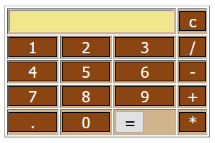
Code Injection example 2
Here we have a simple calculator application (the code is available in Canvas)
It can do any calculation that can be done to PHP to any level of precision that can be done in PHP.
And it’s all been done in a single line of code!
Pretty elegant, right?

Slide 20
Code Injection example 2
How does it work?
Every digit and operator that is typed on the calculator is put into a single form field.
When the “=“ is pressed, the form submits the data to this same PHP file in the field “calcthis”.
<?php eval("echo ".$_GET['calcthis'].";") ?>
The code concatenates the string “echo” at the beginning of the string and a “;” at the end. Then sends the result to the eval command.
So, if we type in “2 + 4 * 6 / 3” the eval command receives: echo 2+4*6/3;
The eval command simply takes whatever is passed to it and executes it as if it’s PHP

Slide 21
Code Injection example 2
So now we have the ability to execute any code inside a piece of PHP code!
What does that let us do that we couldn’t do before? Examine the state of all the variables!
Suppose you knew or could guess that there is a variable called “$username”. Simply passing the following URL would show us the contents of it: http://<<server IP>>/calc.php?calcthis=$username
Makes you wonder if you could get the value of every variable. Right?

Slide 22
Code Injection example 2
There is! The command get_defined_vars() which returns every variable in memory.
One problem is that returns an array rather than just text.
PHP won’t print Arrays directly. Try something like echo Array(“1”,”2”,”3”); and all you get is the word “Array”.
There’s a shortcut function for printing arrays: var_dump()
Combine the two together:
http://<<server IP>/calc.php?calcthis=var_dump(get_defined_vars())
You should be able to see some data in the calculator window. View the page source to see it all!

Slide 23
Code Injection example 2
Having the variables is nice, but can we see the PHP code?
There is a simple PHP command to send the contents of a file to you: readfile();
readfile('calc.php’); would send the php file to us but it would just insert it into the middle of the HTML file.
There’s a far more elegant way…

Slide 24
Code Injection – example 2
ToHere we simply create a header for the HTTP response and send the appropriate data. Note the use of “application/octet-stream”.
avoid problems with spacing and special characters, paste this code into a text editor and remove them -- turning it into a single line. Then feed it to the application on the URL.
It’s worth pointing out that we could have used the exec trick to upload a PHP file to the server which allows us to download any file. There is always more than one way to attack a system!
header('Content-Description: File Transfer'); header('Content-Type: application/octet-stream'); header('Content-Disposition: attachment; filename='.basename('calc.php')); header('Content-Transfer-Encoding: binary'); header('Content-Length: ' . filesize('calc.php')); ob_clean(); flush(); readfile('calc.php');

Slide 25
A1:2017-Injection
solutions

Slide 26
Fixing the problems
The actual code required to fix these applications can be complicated and somewhat beyond the scope of this course.
Generally speaking, you want to do three things:
Sanitize or Reject bad data sent to the application.
Eliminate any part of the application that allows the user to send commands to the operating system..
Restrict or eliminate any part of the application that allows the user to supply code that could be executed by PHP (or other programming language)

Slide 27
Fixing the problems - Sanitize or Reject bad data
Lets’ take a look at the first two of these principles to try and make showdir.php more secure.
Recall that most of our mischief came from using characters like . ; and <
The PHP function trim() allows us to remove any characters we want from a string. Using it like this:
$input = trim($_GET["filter"],";.*><");
Would have stopped any of these special characters from reaching the exec() command.
<?PHP printf ("Contents of the current directory<br><br>"); $input = trim($_GET["filter"],";.*"); if (empty($input)) { $command = "ls"; } else { $command = "ls *.".$input; }
exec($command,$output); foreach ($output as $line) { printf("%s<br>",$line); } ?>

Slide 28
Fixing the problems - Sanitize or Reject bad data
However, that would also have stopped us from using the filter to do something useful. As we could no longer set it to something like *.php
This can be fixed by adding *. to the command itself. However, this causes a problem if the user doesn’t enter any filter. Since ls *. on its own isn’t a valid Linux command.
What we need is the ability to check if the filter variable is empty. One way to do this is to use the empty() function this returns true if the variable is empty.
<?PHP printf ("Contents of the current directory<br><br>"); $input = trim($_GET["filter"],";.*"); if (empty($input)) { $command = "ls"; } else { $command = "ls *.".$input; }
exec($command,$output); foreach ($output as $line) { printf("%s<br>",$line); } ?>

Slide 29
Fixing the problems - Sanitize or Reject bad data
While this stops us from using “..” to roam through the directory structure. It doesn’t stop us from moving into a directory that is in the same place as our application.
This probably isn’t as serious but it’s clearly not the reason the filter parameter was added to this application. We can stop it by making sure that whatever is passed to filter isn’t a directory with the function is_dir()
<?PHP printf ("Contents of the current directory<br><br>"); $input = trim($_GET["filter"],";.*"); if (empty($input)) { $command = "ls"; } elseif (!is_dir($input)) { $command = "ls *.".$input; }
exec($command,$output); foreach ($output as $line) { printf("%s<br>",$line); } ?>

Slide 30
Fixing the problems - Sanitize or Reject bad data
There are probably a few more ways that a hacker could abuse this script but right now we have made it considerably harder to pass bad data and to send commands to the operating system.
Add this code to your own TurnKey Linux system and see if you can find one.
<?PHP printf ("Contents of the current directory<br><br>"); $input = trim($_GET["filter"],";.*"); if (empty($input)) { $command = "ls"; } elseif (!is_dir($input)) { $command = "ls *.".$input; }
exec($command,$output); foreach ($output as $line) { printf("%s<br>",$line); } ?>

Slide 31
Fixing the problems – restricting code execution
Our third principle was to eliminate or restrict the ability to execute code. Here we can look at exactly one part of our calc.php program:
<?PHP eval('echo '.$calc.'; ‘)?>
This line is where all the damage is done. The entire purpose of eval is to execute PHP code.
The obvious way to do this is to re-write the entire application so that it doesn’t allow this. However, there is one method we can use to make it a little safer.
We can tell PHP to ONLY allow certain characters. Specifically: 1234567890-+/*/.
<?PHP if (preg_match('/[^ 1234567890\+-\.\/\*]/',$calc)) { echo "Error";} else { eval('echo '.$calc.';'); } ?>

Slide 32
Fixing the problems - restricting code execution
To do that we want to match the string against that character set and disallow anything that goes outside it. This can be done using a pattern matching system known as regular expressions.
A full course on regular expressions (regexp) is beyond this course but if we take a look at the PHP code fragment which would replace the one from the original script we can get the gist of how it works.
preg_match() takes two parameters: a pattern and a string. The pattern we are passing it is /[^ 1234567890\+-\.\/\*]/ As you can see this contains all the characters that we consider valid for this application. The caret (^) tells the function to match everything that isn’t in this pattern. So this will evaluate to true for any string that contains any other character. When that happens, we simply send back the phrase “Error”.
<?PHP if (preg_match('/[^ 1234567890\+-\.\/\*]/',$calc)) { echo "Error";} else { eval('echo '.$calc.';'); } ?>

